Slide 1
SWITCHING STRESS TEST
FBG20N18

Slide 2
Switching STRESS
Parts were grouped and run at successively higher voltage.
Stress Switching Testing : Tested variations of VDS voltage, IDS current and Switching Frequency in a high side buck converter over multiple 20Hour test times
  VDS Tested : 60 to 240V (Nominal) measured at Power supply and does not include any overshoot occurring at the DUT due to the buck circuit performance.
  Iout tested : 1 to 9A current limited by heat dissipation
  Test period was ~18 hours (Overnight)
  Parts tested with full parametric test on Focused tester after every step.
  Parts with very high leakage were removed at each step
  X axis (voltage represents Applied stress voltage not test voltage)

Slide 3
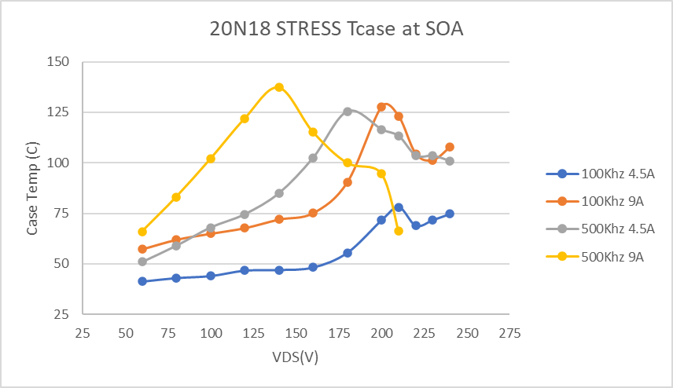
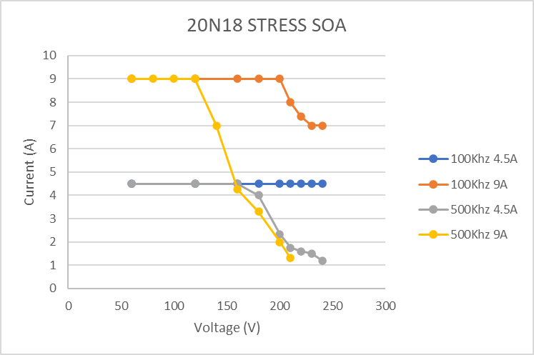
Case temps and SOA limits
Take away : Switching losses are driving Case temp more than current

Slide 4
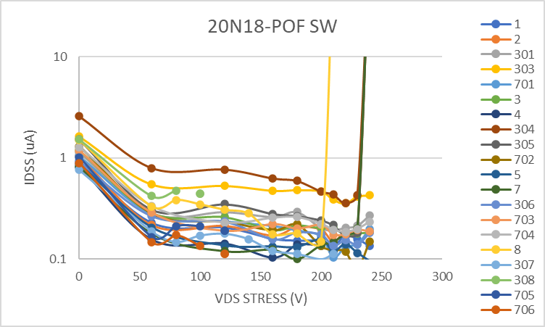
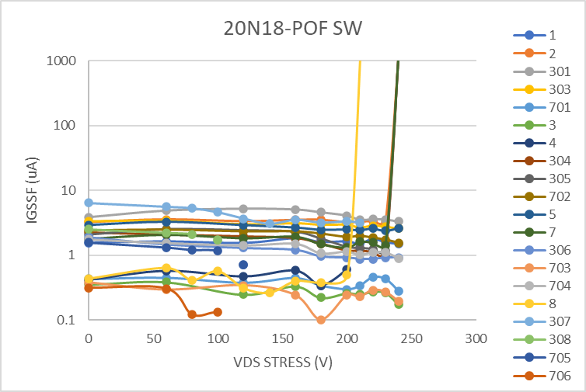
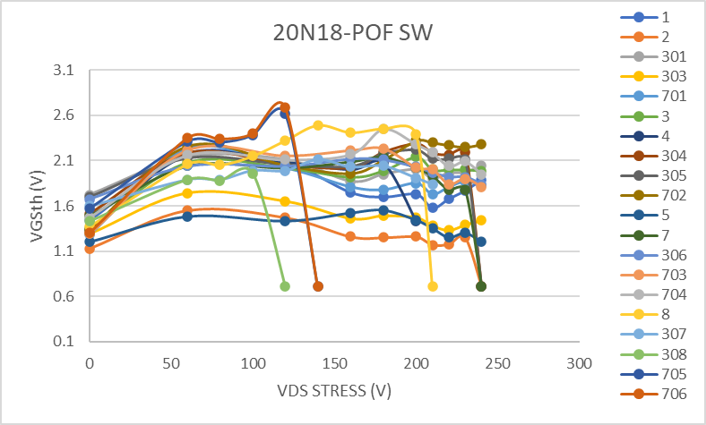
Switching Stress Parametric

Slide 5
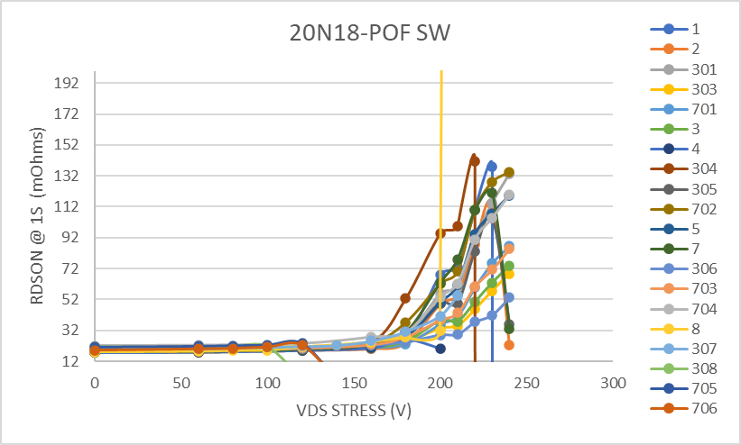
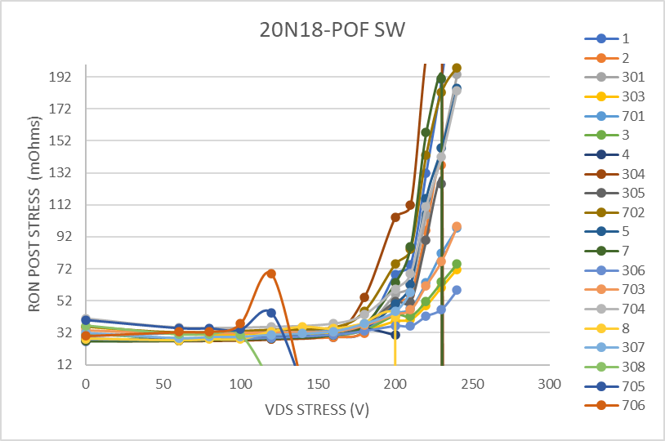
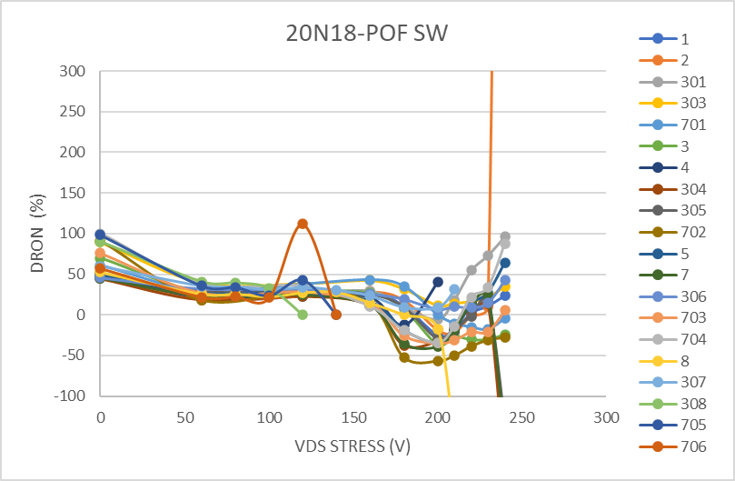
Switching Stress Parametric

